Slide 1
Development of AI/ML based solution for detection of face-swap based deep fake videos
CSE7101- Capstone Project
Review-5
Batch Number: PSCS_314
NAME | ROLL_NO
S SANDEEP KUMAR | 20221CSG0136
YOGESH | 20221CS0G128
L PRAJWAL | 20221CS0G161
Under the Supervision of,
Mr. Himansu Sekhar Rout
Assistant Professor
School of Computer Science and Engineering
Presidency University
Name of the Program: CSG
Name of the HoD: Dr. Anandaraj S.P
Name of the Program Project Coordinator: Dr. Sharmasth Vali
Name of the School Project Coordinators: Dr. Sampath A K , Dr. Geetha A

Slide 2
DETAILS
Organization: National Technical Research Organisation (NTRO)
Category: Software.
Problem Description:
This project is the development and evaluation of an AI/ML solution to detect face-swap deepfake videos, focusing on a Recurrent Convolutional Strategy.
The core of the project is a hybrid CNN-LSTM model designed to analyze videos for both spatial artifacts (like unnatural textures in a single frame) and temporal inconsistencies (like flawed blinking patterns over time).
The models will be trained and tested on challenging public datasets like FaceForensics++ and Celeb-DF, with the ultimate aim of demonstrating the superior effectiveness of a spatio-temporal model in combating sophisticated digital forgeries.

Slide 3
Problem Statement
The Challenge of Hyper-Realistic Deepfakes
(problem statement number:PSCS_314)
The rapid rise of Generative AI has enabled the creation of hyper-realistic face-swap deepfake videos, blurring the line between authentic and synthetic media.
This technology poses a severe threat to society through political disinformation, financial fraud, and personal defamation.
Existing detection methods often fail to generalize against new forgery techniques and struggle to identify subtle temporal inconsistencies that reveal a video's true nature.

Slide 4
Index
THE PROBLEM EXPLANATION
GAP AND OBJECTIVE
ARCHITECTURE OVERVIEW
DATASET AND TRAINING
CORE METHODOLOGY
EXPLAINABILITY
RESULTS
APPLICATION AND ETHICS
CONCLUSION
GANTT CHART
REFERENCES
GITHUB LINK

Slide 5
THE PROBLEM EXPLANATION
Deepfakes are now used primarily for malicious purposes. They accelerate misinformation, fuel political manipulation, enable financial scams, and support identity theft. Most current detectors can classify deepfakes accurately, but they fail to provide any justification or visual evidence. As a result, they cannot be trusted in legal or forensic settings. The scale of the threat has surged dramatically, with deepfake content growing more than five times between 2019 and 2023.

Slide 6
GAP AND OBJECTIVE
The research gap is not performance—it is transparency. Existing systems behave like black boxes: they cannot point to manipulated areas, cannot justify their decisions, and cannot support human verification.
This project aims to build a detector that both performs well and explains itself. The system achieves 88.33% classification accuracy, a ROC-AUC of 0.937, full explainability coverage, and a real-time response of under a second per video.

Slide 7
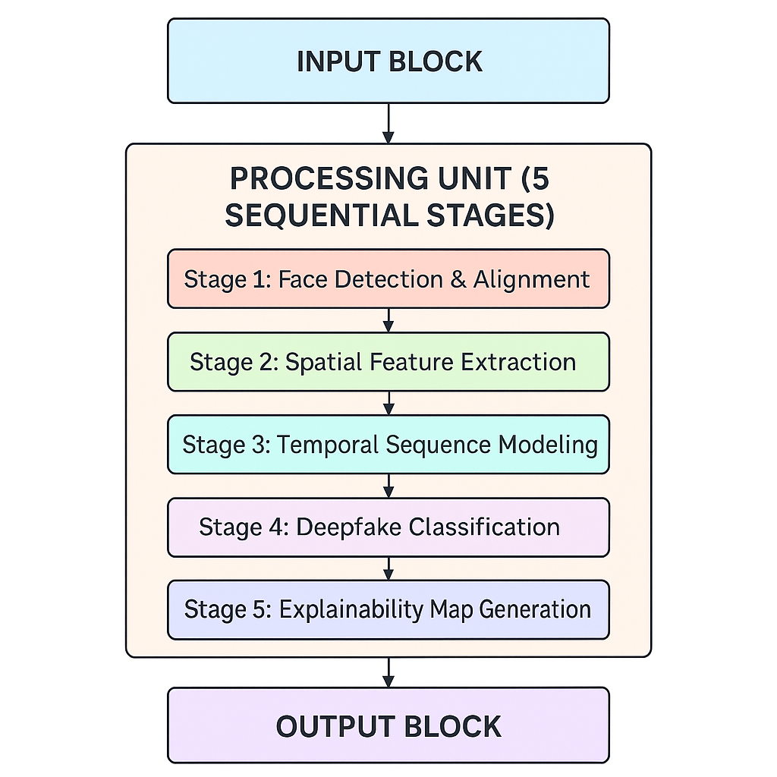
ARCHITECTURE OVERVIEW
The pipeline begins with MTCNN, which isolates and aligns faces from video frames. DenseNet-121 then captures spatial inconsistencies typical of synthetic faces, generating rich feature embeddings. These embeddings are processed by a bidirectional GRU that evaluates how facial artifacts behave across time. The final layer applies Grad-CAM, producing visual attention maps that highlight suspicious regions and justify each prediction.

Slide 8
DATASET AND TRAINING
The model is trained on the Google DeepFake Detection dataset, which offers more than three thousand videos from real actors and professionally generated manipulations. The data is split in a balanced manner to prevent bias. Training uses Adam optimization with binary cross-entropy loss and early stopping. The complete model converges within 18 epochs on consumer-level hardware, demonstrating realistic deployment feasibility.

Slide 9
CORE METHODOLOGY
Face preprocessing uses MTCNN to detect landmarks, align faces, and standardize input to 224×224 resolution. From each video, 30 representative frames are extracted. DenseNet-121 reduces redundancy through dense connections, generating 1024-dimensional descriptors that capture subtle distortions introduced by deepfake generators.
Temporal modeling is handled by a bidirectional GRU. Fake content exhibits abnormal stability of artifacts across frames, while genuine videos show natural variation. The model learns this difference and uses it to strengthen classification.

Slide 10
EXPLAINABILITY
Grad-CAM highlights the regions most responsible for a prediction. Instead of a raw probability value, the system produces a heatmap that overlays the face and visually reveals manipulation hotspots such as the jawline, mouth, or nose. Each sample is explained automatically, and the additional computation is negligible. The detector does not just classify—it proves its reasoning.

Slide 11
RESULTS
The system consistently surpasses its targets. On the test set, classification accuracy reaches 88.33% and ROC-AUC reaches 0.937. Ablation studies show clear contribution from every component: DenseNet alone forms a solid baseline, temporal modeling via GRU brings a significant boost, and bidirectional processing provides the best performance. Grad-CAM introduces transparency without degrading results. Compared to widely used methods such as XceptionNet or ResNet-LSTM, the proposed framework is both faster and more informative.

Slide 12
APPLICATION AND ETHICS
A Streamlit dashboard turns the system into a usable tool: upload a video, receive a prediction, visualize the heatmap, analyze regional suspicion, and export findings when necessary. Ethical constraints are built into the design. Processing remains local to protect privacy, demographic bias is monitored, and human verification remains central to deployment. The framework is transparent by design, not obscured in proprietary models.

Slide 13
CONCLUSION
The project addresses deepfake detection from a practical, forensic perspective. Instead of trading accuracy for explainability, it combines both and proves that transparent detection is possible in real time. The framework strengthens trust, supports high-stakes decision-making, and sets a direction for responsible AI systems. Questions / Contact.

Slide 14
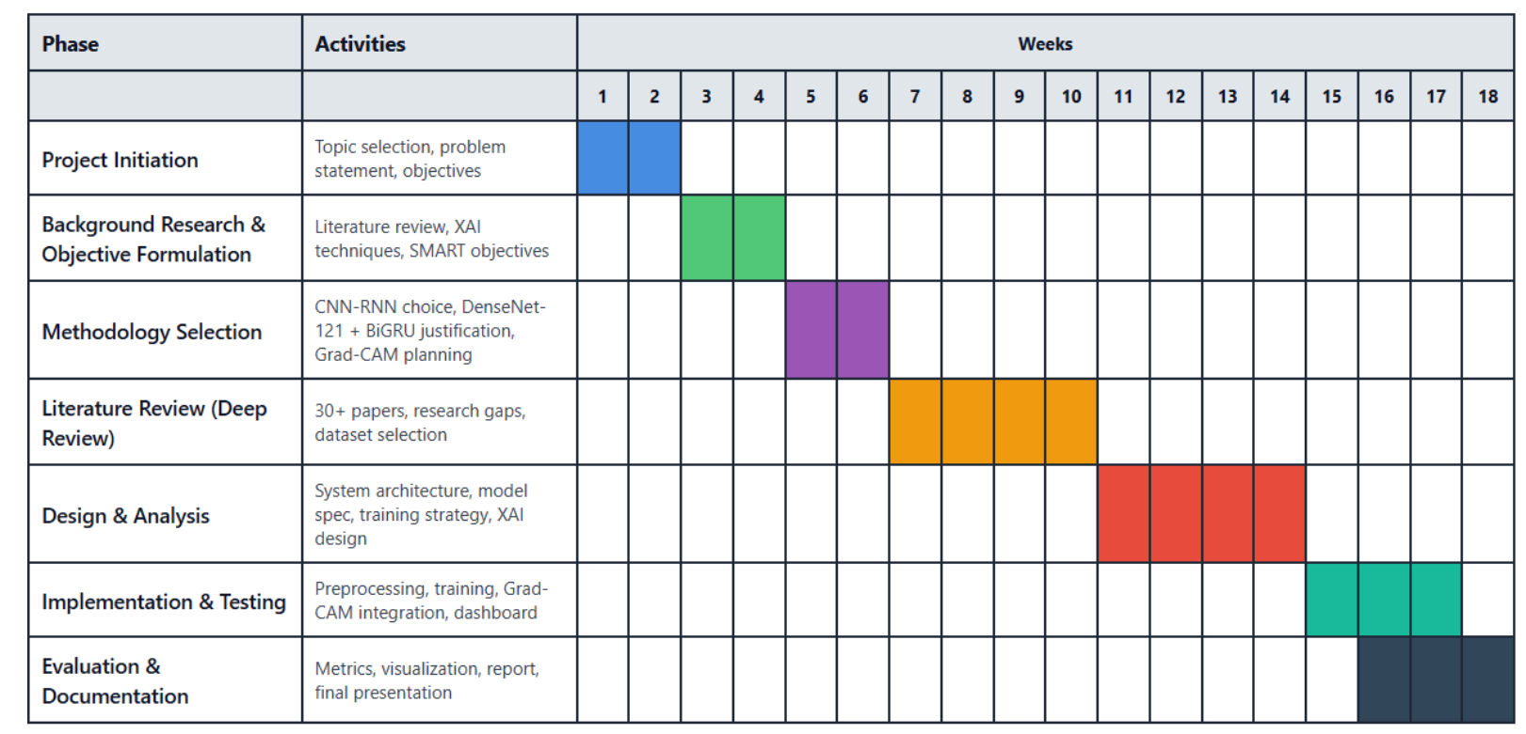
GANTT CHART

Slide 15
REFERENCES
PyTorch [1] - Deep learning framework used for model development and training
MTCNN [2] - Multi-task Cascaded Convolutional Networks for face detection pipeline and preprocessing
Streamlit [3] - Framework for building the interactive dashboard and user interface
DenseNet-121 [4] - Convolutional neural network architecture for spatial feature extraction
BiGRU [5] - Bidirectional Gated Recurrent Unit for temporal consistency modeling
Grad-CAM [6] - Gradient-weighted Class Activation Mapping for explainability and attention visualization
GDPR [16] - General Data Protection Regulation for privacy compliance and data protection guidelines
Misinformation Research [18] - Studies on false negative risks and misinformation spread
Demographic Bias Research [22] - Research on MTCNN performance variations across demographics
(References From The Report)

Slide 16
GITHUB LINK
Github Link
https://github.com/SandeepKumar-san/CSG31_PSCS314_DEEPFAKE-DETECTION

Slide 17


